Slide 1
Database Services During Run2
WLCG Collaboration Workshop
Okinawa April 11th,2015
Luca Canali, CERN IT-DB

Slide 2
Outline
Status, evolution and readiness for RUN 2 of Oracle database services
DB on Demand service
Scale-out Databases on HADOOP

Slide 3
Oracle Database Services – Evolution in LS1
Software upgrades
Upgraded Oracle version for all DBs
Moved to RHEL6 and puppet
Hardware upgrades
New generation of servers and storage
Production now in the BARN (critical power)
Disaster-recovery from Safehost to Wigner
SW upgrades have combined with HW move
Has allowed to reduce downtime and risk

Slide 4
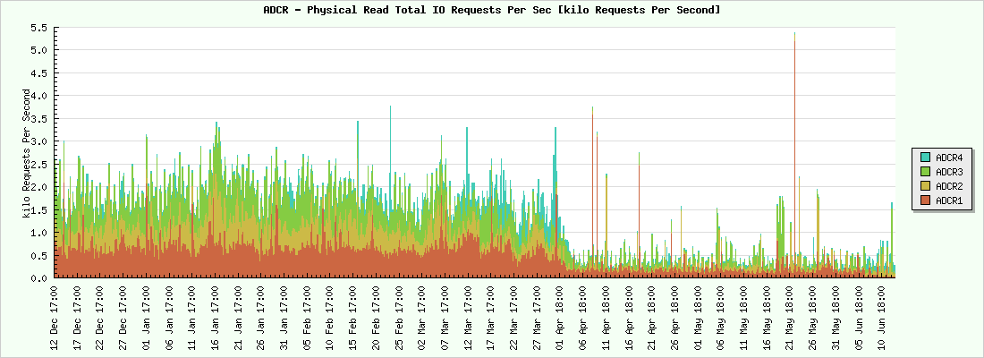
New Servers – More Capacity
New DB servers have more memory
From 48GB -> to 128GB / 256GB
Beneficial for performance of transactional workloads
Also increased CPU capacity (N# cores from 8 to 16)
HW Migration
Notes:
Old servers deployed Westmere (E5630), new servers use Sandy Bridge (E5-2650)

Slide 5
Storage Evolution: Increased Capacity and Performance
 | NetApp FAS3240 (OLD) | NetApp FAS8060 (NEW)
NVRAM | 1.0 GB | 8.0 GB
System memory | 8GB | 64GB
CPU | 1 x 64-bit 4-core 2.33 Ghz | 2 x 64-bit 8-core 2.10 Ghz
SSD layer (maximum) | 512GB | 8TB
Aggregate size | 180TB | 400TB
OS controller | Data ONTAP® 7-mode | Data ONTAP® C-mode*

Slide 6
Notable Software Changes
Oracle version evolution
Production upgraded to Oracle 11.2.0.4
Proven to be a stable version, smooth upgrades
12.1.0.2 is the latest available version
Currently upgrading 12.1.0.1 DBs to this release
Oracle has announced the next release, 12.2, for 2016
PVSS upgrades
Upgraded all WINCC/PVSS schemas to latest version 8.9 CERN 1.2

Slide 7
Notable New Oracle DB Services
QPSR
Quench Protection System
WinCC/PVSS data, sustained rate ~150 K rows/second
1M rows/second peak achieved during stress testing
Performance of the new HW instrumental to achieve this
SCADAR
Consolidated WinCC/PVSS archive repository
Will store ~50K rows/second (may increase in the future)
the data retention varies depending on the application (from a few days to 5 years)

Slide 8
Replication Evolution
Technology evolution:
Conditions replication to Atlas Tier 1 sites now uses Golden Gate
Replication from online to offline DBs
Active Data Guard
Some reaming use of streams set to phase out
See also
“Evolution of Database Replication Technologies for WLCG”, CHEP Monday 13/4 at 14:15

Slide 9
Some Important Trends for Transactional Databases
Server capacity is growing fast also for commodity HW
Large increase in available memory
SSD storage becoming more affordable
Servers have increasing CPU power (typically more cores)
Opportunities
Consolidation: reduce HW and management costs
Review of application architectures
More and more DB workloads fit into server memory
Opportunity to reduce complexity in favour of simpler architectures

Slide 10
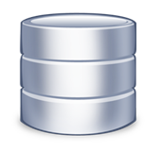
CERN Oracle Databases have run successfully in RUN1
~100 Oracle databases, most of them RAC
~500 TB of data files for production DBs in total
Used for physics, IT, accelerators, administration
Oracle is feature-rich
Enterprise class DB
Solutions for high availability, disaster recovery, backup, monitoring, replication, proven for concurrent transactional processing
Oracle DBAs available for consultancy

Slide 11
DB on Demand
Self-service for provisioning, management, backup
The number of deployed instances is growing
MySQL (85%), PostgreSQL (10%) and Oracle (5%)
Number
of deployed DBoD Instances
Time

Slide 12
Additional Stats for DBoD
Openstack
Puppetdb (MySQL)
LHCB-dirac
Atlassian databases
LCG VOMS
Geant4
Hammercloud dbs
Webcast
QC LHC Splice
FTS3
DRUPAL
CERNVM
VCS
IAXO
UNOSAT
…

Slide 13
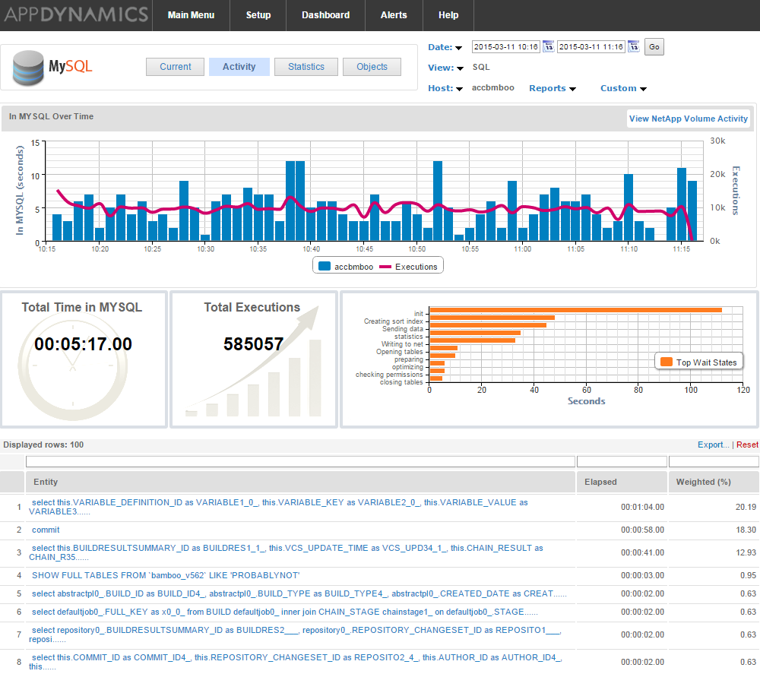
DBoD new monitoring tool
Appdynamics
Allows DBoD users to troubleshoot performance problems with a GUI interface

Slide 14
DBoD Evolution
Completed:
Migration to new HW (servers and storage)
Migration to CERN Agile Infrastructure
High Availability cluster solution based on Oracle
Plans for 2015:
Automation: instance creation, storage, puppet…
Reduce waiting time to obtain your instance
Cloning
Backups verification
Test schema/DBMS upgrades
Replication: MySQL & PostgreSQL
Business continuity and data protection
Upgrades: Oracle 12.1, MySQL 5.6.x, PostgreSQL 9.3.x
See also: CHEP poster “Database on Demand” by Ruben Gaspar Aparicio and Ignacio Coterillo

Slide 15
Support Levels in RUN 2
Oracle Database Service support
24/7 CERN piquet in Run 1
A review has been made with the experiments for Run2
Oracle piquet support will start mid May 2015
We will then re-evaluate in 2016 if needed
DB-on-demand services have grown from being “nice to have” to being essential to both experiment and Grid services
New management interface and monitoring with AppDynamics
A best effort SLA will be provided for a number of critical databases, details to be announced later in 2015

Slide 16
Scale-out Databases
Scale-out, shared-nothing architectures have appeared and are quickly growing in adoption
Performance and low-cost
Back-end: HADOOP or DB-specific
Engine on top of HADOOP cluster
Useful for
Data warehousing, reporting, analytics workloads
Ex: Logging systems, controls dashboards, auditing, archives

Slide 17
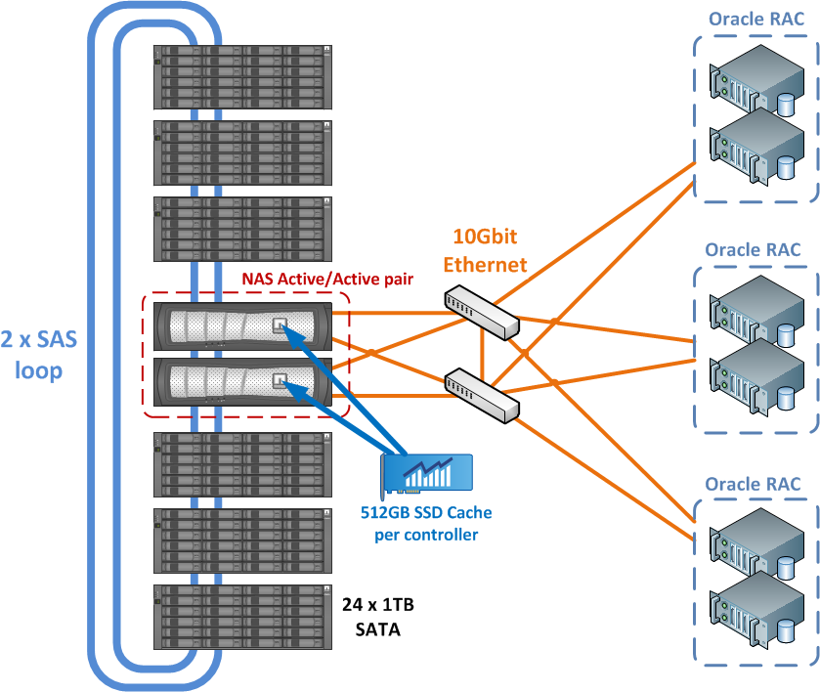
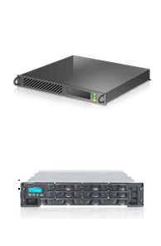
Example of Oracle RAC deployed with shared storage
Interconnect
Node 1
Node 2
Node n
Queries run in parallel on the cluster nodes
The shared nothing architecture allows to scale for high capacity and throughput on commodity HW

Slide 18
Hadoop Ecosystem and Databases
It’s a full ecosystem, many components
HDFS provides the shared-nothing scalability
Specialized data formats for
compression, partitioning and column-oriented storage
Query engines
Declarative (SQL) Impala, Spark SQL, Hive
Imperative: Yarn/Map Reduce, Spark
Loading tools also important (sqoop, flume, ..)

Slide 19
Offloading Data into HADOOP
We are building HADOOP-based systems for offloading resource-intensive queries
Controls data (PVSS) write once read-many
Accelerator log DB is now 200 TB + 90 TB/year
Offline database for SCADA (EN controls)
Analytics: working with CMS on popularity
Projects in collaboration IT-DB and IT-DSS
See also CHEP poster “Scale out database for CERN use cases” Z. Baranowski et al.

Slide 20
Conclusions
Oracle database services
Proven and stable infrastructure and support levels
Hardware refresh and software upgrades during LS1
Database on demand services
Established platform and growing fast
Offer MySQL, PostgreSQL and Oracle services
HADOOP-based databases
For data warehouse, reporting and analytics
First results very promising, more development in progress
Many thanks to the experiments, application DBAs and Tier 1 DBAs for their help and collaboration

