Slide 1
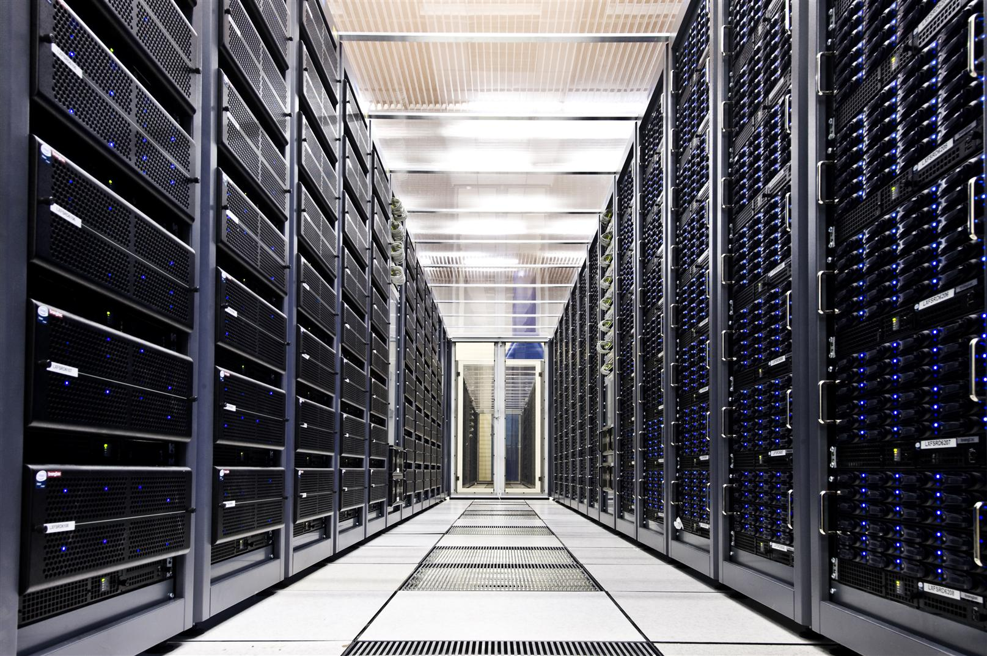
Stack Traces and Flame Graphs for Oracle Troubleshooting
Luca Canali, CERN
UKOUG, Birmingham, December 6th, 2015

Slide 2

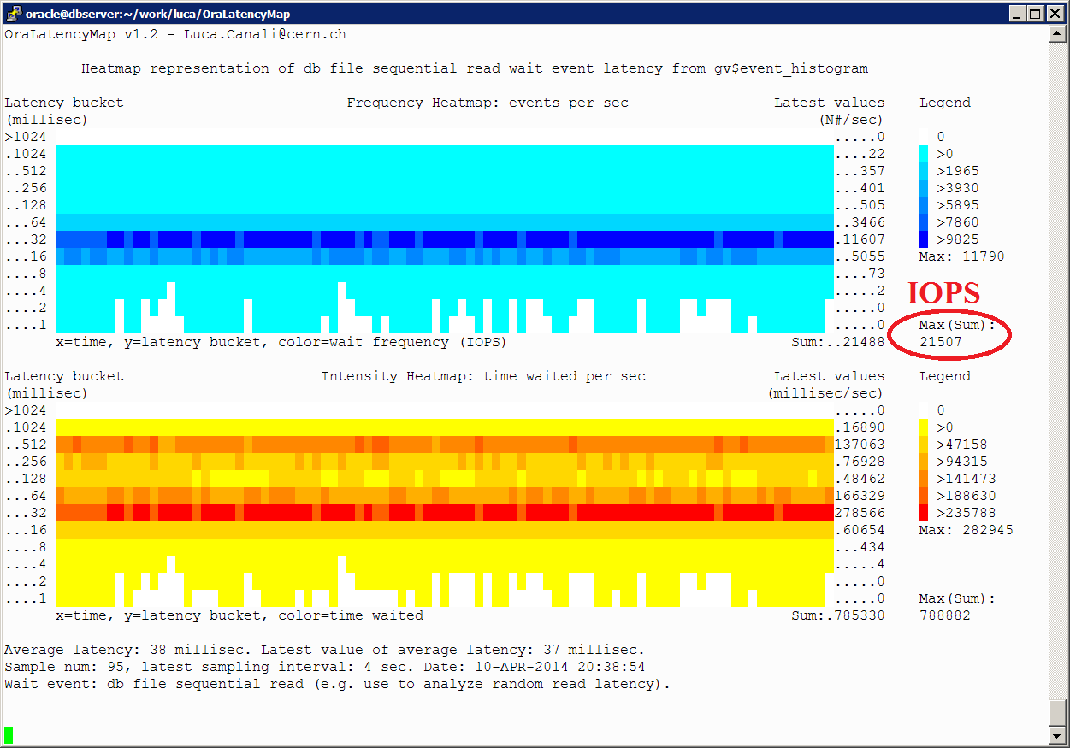

About Luca
Senior DBA and team lead at CERN IT
  Joined CERN in 2005
  Working with Oracle RDBMS since 2000
Passionate to learn and share knowledge, how to get most value from database technology
@LucaCanaliDB and http://cern.ch/canali

Slide 3
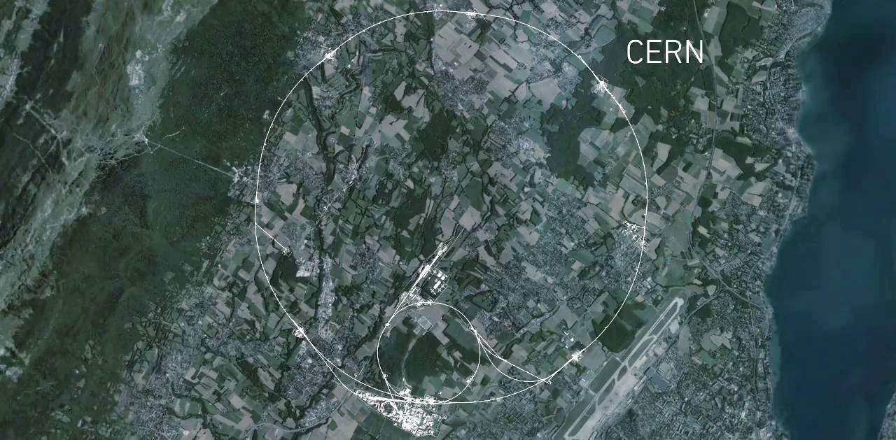
Large Hadron Collider – Run 2:
Resumed Operations after Upgrades
CMS
ALICE
ATLAS
LHCb

Slide 4
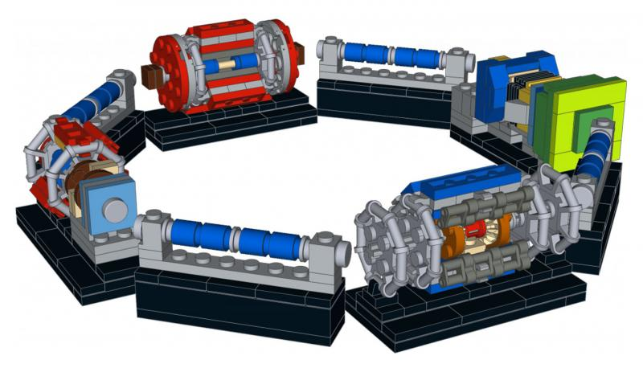
In 2015 Proton-Proton Collisions at 13 TeV (was 8 TeV in 2013)
http://build-your-own-particle-detector.org/models/lhc-micro-models

Slide 5
Agenda
Basic techniques for stack backtraces
Stack profiling
Visualization with flame graphs
Examples

Slide 6
Motivations and Context: Troubleshooting
How understand the workload?
You need the right tools for the job
  What is the system doing?
  Where is the time spent?
Oracle has mature instrumentation
  Wait event model, ASH, AWR, SQL monitor and a large amount of info on V$ etc

Slide 7
Why OS-Level Tools?
When wait events are not available
  Servers with large memory means queries operating mostly ‘on CPU’
When wait events are not enough
  Measure I/O latency, understand what is inside I/O waits
Exploring Oracle internals
  For those cases where we need to drill down deeper

Slide 8
OS Tools
Standard tools: top, vmstat, pidstat, iostat, sar, /proc, …
Modern tools for dynamic tracing: DTrace, SystemTap, perf-events, …
Stack tracing
  Tools: sqlplus with oradebug, gdb, perf-events, custom tools, /proc/<pid>/stack

Slide 9
Stack Trace Using SQL*Plus
Sqlplus: oradebug
  Many diagnostic functions, including stack tracing
  Note: ignore overhead at the top of the stack
SQL> oradebug setospid <pid>
SQL> oradebug dump callstack 1
SQL> oradebug dump errorstack 1
SQL> oradebug short_stack
ksedsts()+244<-ksdxfstk()+58<-ksdxcb()+918<-sspuser()+224<-__sighandler()<-pread64()+19<-ksfd_skgfqio()+303<-ksfd_io()+823<-ksfdread()+182<-kfk_ufs_sync_io()+797<-kfk_submit_ufs_io()+88<-kfk_submit_io()+114<-kfk_io1()+989<-kfkRequest()+32<-kfk_transitIO()+1248<-kfioSubmitIO()+3085<-kfioRequestPriv()+218<-kfioRequest()+685..[EDITED]..<-__libc_start_main()+253

Slide 10
Stack Traces, SQL Trace and Wait Events
Advanced syntax for events and tracing
  Credits: I first learned about this from Tanel Poder
  Examples:
SQL> alter session set events 'sql_trace callstack(1)'; --11g
SQL> alter session set events 'wait_event["<wait event name>"] trace("shortstack: %s\n", shortstack())'; --12c
shortstack: kslwtectx<-ksfdafRequest<-ksfdafIO<-ksfd_io<-ksfdread<-kcfrbd1<-kcbzib<-kcbgtcr<-ktrget2<-qeilbk1<-qeilsr<-qerixtFetch<-qertbFetchByRowID<-opifch2<-opiall0<-opikpr<-opiodr<-rpidrus<-skgmstack<-rpiswu2<-kprball<-kqdobr<-kqrReadFromDB<-kqrpre1<-kqlhdlod<-kqls

Slide 11
Stack Traces with OS tools
Standard OS tools for stack tracing:
  gdb, gnu debugger, use ‘bt’ command for stack backtrace
  Wrappers on top of gdb: pstack, gstack
Example:
$ pstack 24318
#0 0x000000340ae0f0c3 in __pread_nocancel () from /lib64/libpthread.so.0
#1 0x000000000cda5bd7 in skgfqio ()
#2 0x000000000cc81bcf in ksfd_skgfqio ()
#3 0x000000000cc7ca57 in ksfd_io ()
#4 0x000000000cc7c156 in ksfdread ()
#5 0x00000000060ada9d in kfk_ufs_sync_io ()
#6 0x00000000060acba8 in kfk_submit_ufs_io ()
#7 0x00000000060ab612 in kfk_submit_io ()
#8 0x00000000060a848d in kfk_io1 ()
#9 0x00000000060a7e90 in kfkRequest ()
...
#55 0x0000000000bbd83c in main ()

Slide 12
More Linux Tools for Stack Tracing
Lsstack64 using ptrace and libunwind: https://github.com/jarun/lsstack64
Tbstack: more lightweight, async stack unwinding -> https://github.com/tbricks/tbstack
$ ./tbstack 24970
-------------------- thread 1 (24970) --------------------
000000340ae0f0c3 pread64 + 0x13
000000000cda5bd7 skgfqio + 0x227
000000000cc81bcf ksfd_skgfqio + 0x12f
000000000cc7ca57 ksfd_io + 0x337
000000000cc7c156 ksfdread + 0xb6
00000000060ada9d kfk_ufs_sync_io + 0x31d
00000000060acba8 kfk_submit_ufs_io + 0x58
. . .
000000340aa1ed5d __libc_start_main + 0xfd
0000000000bbd679 _start + 0x29
----------------------- summary --------------------------
time the process was frozen: 0ms 808us
Notes:
Notes:
lsstack64
https://github.com/jarun/lsstack64
requires install libunwind8 libunwind8-dev and binutils including devel
requires binutils-devel.x86_64 (for bfd.h)
export LD_LIBRARY_PATH=/usr/local/lib
----tbstack
https://github.com/tbricks/tbstack
requires install libunwind and libelf (including devel)
yum install elfutils-libelf-devel.x86_64
make LIBUNWIND_DIR=/root/libunwind-1.1/
export LD_LIBRARY_PATH=/usr/local/lib
When using fedora just install dnf install libunwind*
For OL/RHEL install libunwind from source
https://github.com/pathscale/libunwind
http://download.savannah.gnu.org/releases/libunwind/?C=M;O=A
This may be needed:
cd libunwind/include
ln -s tdep/dwarf-config.h .
./configure
make
make install

Slide 13
Kernel Stack Backtrace From /proc
/proc/<pid>/stack
Requires kernel built with CONFIG_STACKTRACE
  Notably, available in RHEL6 / OL6
  Check: grep CONFIG_STACKTRACE /boot/config-`uname -r`
$ cat /proc/25894/stack
[<ffffffff811d260d>] __blockdev_direct_IO_newtrunc+0xb7d/0x1270
[<ffffffff811d2d77>] __blockdev_direct_IO+0x77/0xe0
[<ffffffff811ceff7>] blkdev_direct_IO+0x57/0x60
[<ffffffff811293db>] generic_file_aio_read+0x6bb/0x700
[<ffffffff811ce4e1>] blkdev_aio_read+0x51/0x80
[<ffffffff811918da>] do_sync_read+0xfa/0x140
[<ffffffff811921d5>] vfs_read+0xb5/0x1a0
[<ffffffff8119233a>] sys_pread64+0x7a/0x90
[<ffffffff8100b0d2>] system_call_fastpath+0x16/0x1b
[<ffffffffffffffff>] 0xffffffffffffffff

Slide 14

Stack Profiling and Sampling
Evolves from typical usage of stack info
  Repeated samples of stack backtraces
Answer questions
  Is anything changing between samples?
  What are the most common code paths?
Analogy: the flip book

Slide 15
Basic example: Workload with a Network Bottleneck
SQL> SELECT * FROM LARGETABLE;
  Note also SQL> SET AUTOTRACE TRACEONLY
Data transfer over slow network
  port forwarding into a VM: putty -P <forwarded_port> -L 1111:DB_server:1521 oracle@VM_host
Oracle process cannot “pump data”: mostly idle
[root@MYDB]# pidstat -p 9124 1 10
Linux 2.6.32-573.7.1.el6.x86_64 (MYDB) 10/22/2015 _x86_64_ (4 CPU)
10:10:28 PM PID %usr %system %guest %CPU CPU Command
10:10:29 PM 9124 0.00 4.00 0.00 4.00 0 oracle_9124_orc
10:10:30 PM 9124 4.85 4.85 0.00 9.71 2 oracle_9124_orc
10:10:31 PM 9124 1.00 2.00 0.00 3.00 2 oracle_9124_orc

Slide 16
KStackSampler
A basic sampler of the kernel stack and process state, written in shell script
...
for x in $(seq 1 $iterations); do
cat /proc/$pid/stack # get kernel stack trace from /proc
# this is an approximation as the process state may have
# changed to runnable in the meantime
grep -m 1 State /proc/$pid/status
echo "1" # this makes the output ingestible by
# FlameGraph/stackcollapse-stap.pl
echo ""
sleep $interval
done
...

Slide 17
Kernel Stack Sampling
Step1: Kernel stack and OS state sampling
  Using https://github.com/LucaCanali/Stack_Profiling
Step2 : Flame Graph
  Using https://github.com/brendangregg/FlameGraph
$ ./kstacksampler.sh -p 9124 -n 100 -i .05 | grep -v 0xffffffffffffffff | sed 's/State:\t//g'| sed 's/\[<.*>] //g' >stack_sample_example1.txt
$ cat stack_sample_example1.txt | ../FlameGraph/stackcollapse-stap.pl | ../FlameGraph/flamegraph.pl --title "Kernel stack profiling - Example 1, network-related bottleneck"> kstacksampler_network_bottleneck_Fig1.svg

Slide 18
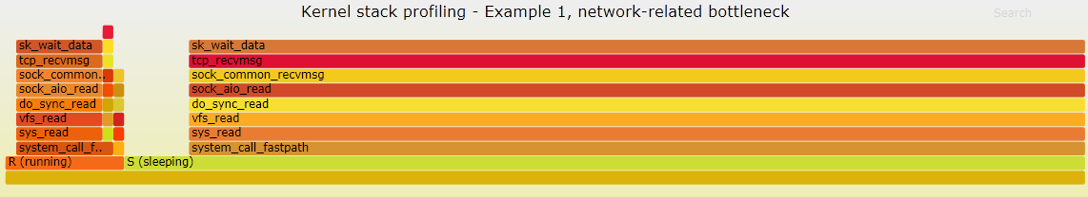
Flame Graph for Analysis
Stack traces and OS status are collapsed and sorted, colours added to provide contrast
Line length proportional to the number of samples (most popular functions have longer lines)
Finding: Oracle process is waiting for network messages
  Confirmed with Oracle wait interface: session mostly waiting for “SQL*Net message from client”
Notes:
Note this is intended as a simple example that can be analysed both with Oracle wait events and with flame graphs, therefore providing a control of the result.

Slide 19
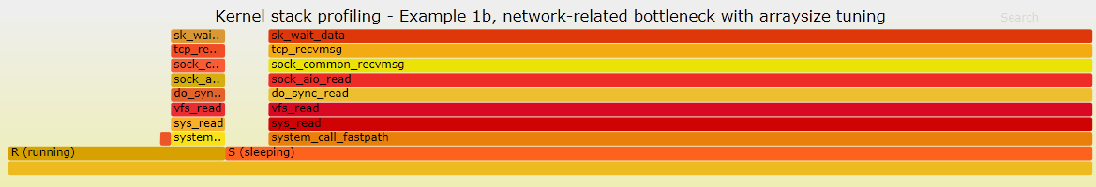
Actionable Information
From previous graph we see a network bottleneck
How to make improve the throughput?
  Action: reduce impact of round trips
  Sqlplus: "SET ARRAYSIZE 5000"
Results:
  The flame graph shows more time is spent running in userspace mode (more work being done)
  DB metrics confirm data throughput increase

Slide 20
Comments on Flame Graphs
Help to identify most common code paths
  where most time is spent
The current function is at the top of the stack
  Parent functions in lower layers add context
Gotcha: the horizontal axis is not time!
  Stacks are collapsed and sorted
Gotcha: sampling frequency is important
  Trade off accuracy vs. overhead
Gotcha: need to know if you are capturing all workload or only parts
  Perf for example only captures processes on CPU

Slide 21
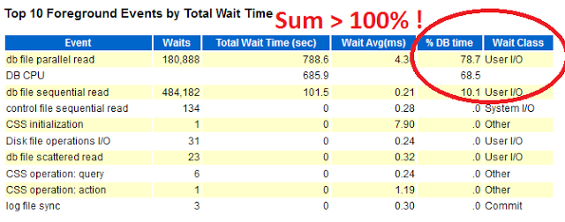
Example: Wait Event Investigation
AWR report shows: %CPU + %WAIT > 100%
Will use extended stack profiling for investigating
  Wait events and CPU usage
Extract from the AWR report:
Case first discussed by John Beresniewicz (JB) at Oak Table World 2015

Slide 22

The Test System
Workload: Oracle process random read
Tool: http://kevinclosson.net/slob/
Test system is in a VM
  Oracle 12.1.0.2 with ASM (block device storage)
  Fast I/O, DB files are cached in host RAM (128 GB)
  Only one active process
  No significant additional load on the system

Slide 23
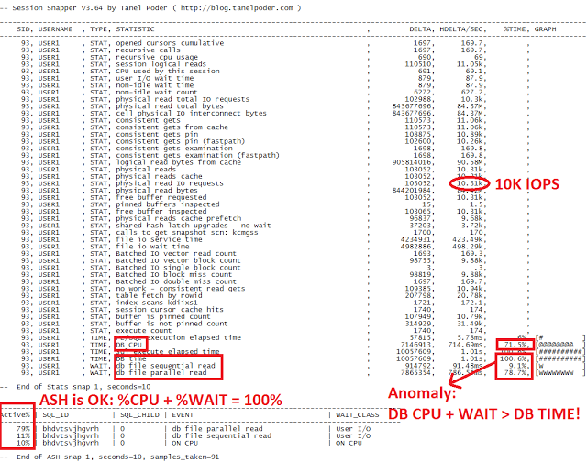
Tanel’s Snapper Data

Slide 24
Extended Stack Profiling
ORA_KStackProfiler a tool for:
  sampling /proc/<pid>/stack to sample the kernel stack trace if any
  sampling of /proc/<pid>/stat to measure the process state (Running, Sleeping, Disk, etc),
  sampling the status of the Oracle session (on CPU of waiting for a wait event).
    The sampling is done directly from SGA (X$KSUSE)

Slide 25
ORA_KStackProfiler - Example
SQL> @find_pid_ksustim_ksuseopc.sql
This script finds the OS pid and address of X$KSUSE.KSUSEOPC and X$KSUSE.KSUSETIM for a given Oracle session. To be used together with ora_kstackprofiler. Run as user SYS.
Enter Oracle SID to be investigated: 111
OS pid = 1234, ksuseopc = 5796061762, ksusetim = 5796061792
3. Stack traces sampling extended with Oracle wait event data as in the following example:
./ora_kstackprofiler --pid 1234 --delay 100 --count 1000 --ksuseopc 5796061762 --ksusetim 5796061792 > ora_stack_slob_fastio.txt
4. Process the output with additional filtering and with flame graphs for visualization using https://github.com/brendangregg/FlameGraph
cat ora_stack_slob_fastio.txt| grep -v 0xffffffffffffffff |
sed -f oracle_scripts/eventsname.sed | ../FlameGraph/stackcollapse-stap.pl| ../FlameGraph/flamegraph.pl --title "Flame Graph of Oracle random I/O (SLOB)“
> ora_stack_slob_fastio.svg

Slide 26
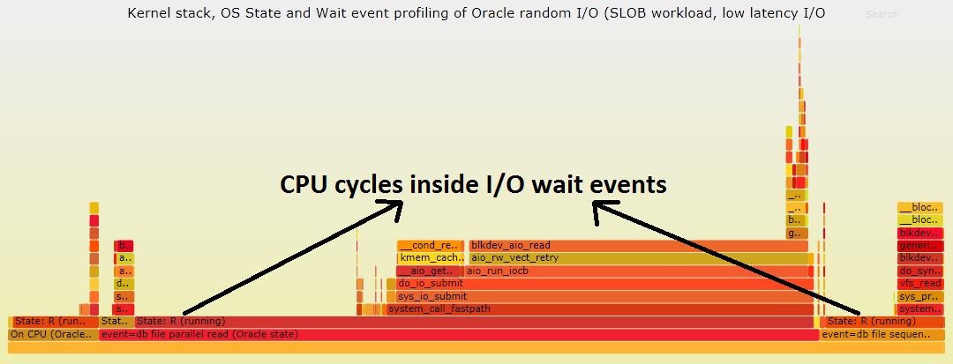
Flame Graph and Analysis
Kernel stack, with OS state and wait events
Finding: many CPU cycles inside I/O wait events

Slide 27
What Is the Added Value of The Flame Graph Analysis
Extended stack profiling and flame graph
  Provide direct evidence that CPU is used inside the wait event
Why CPU Time + Wait Time > DB Time?
  Oracle measures wait events by timing the begin and end of the related operations (in this case system calls for I/O)
  CPU time is measured by OS, independently of Oracle
  The two measurements overlap (double counting of CPU which can be important, as in the previous example)

Slide 28
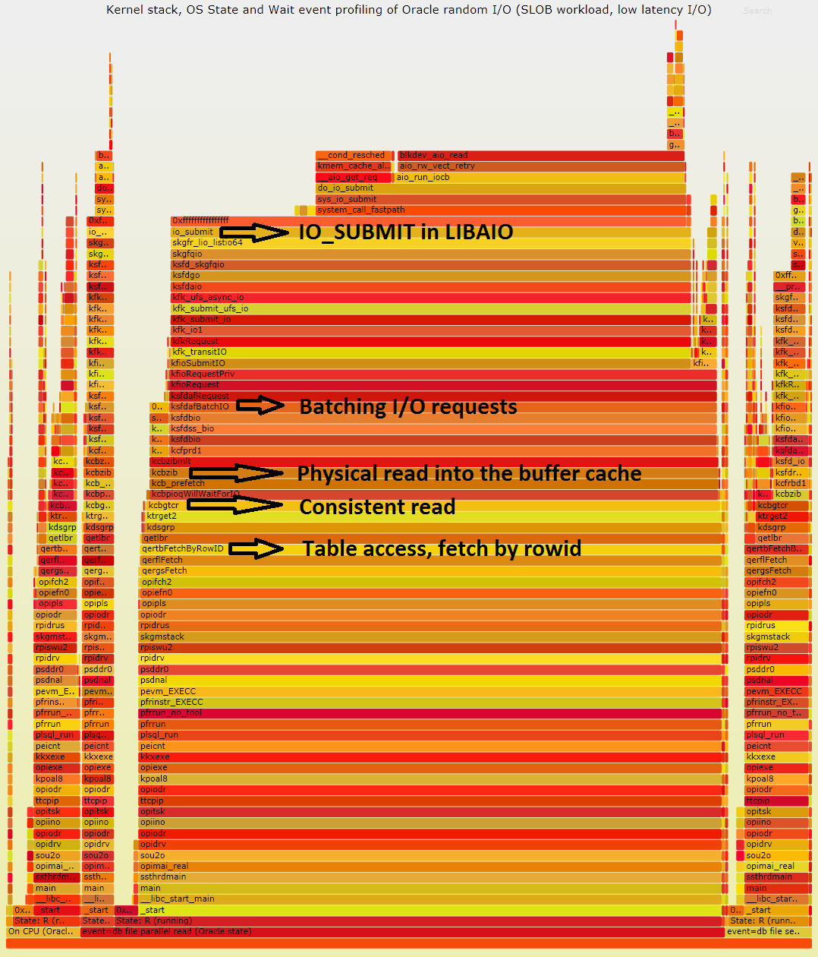
Stack Profiling with Userspace
Ptrace_Profiler:
/proc/pid/stack
Userspace trace
/proc/pid/stat
Wait Event from X$KSUSE/SGA
Adds context to understand workload

Slide 29
Notes on Ptrace_Profiler
On-off CPU sampling
  Written in C, profiles stack, OS, wait events from SGA
  Gathers data both if the session is on or off CPU
  Not only for Oracle, use mainly for non CPU-bound.
Important limitations
  Inaccurate as collection from different data sources is not atomic
  Important overhead from userspace stack collection and unwinding, currently using libunwind-ptrace
Link:
  https://github.com/LucaCanali/Stack_Profiling

Slide 30
Additional Investigation on I/O
High CPU usage in kernel mode because of high I/O rate and low latency
Direct measurement of I/O latency
  Use tracepoints for block I/O.
  Example with Ftrace (based on B. Gregg’s work)
# ./iolatency_micro 10
Tracing block I/O. Output every DeltaT = 10 seconds. Ctrl-C to end.
>=(mus) .. <(mus) : IOPS IO_latency/DeltaT |IOPS Distribution |
16 -> 32 : 0 0 | |
32 -> 64 : 623 29947 |#### |
64 -> 128 : 6302 605049 |######################################|
128 -> 256 : 3482 668659 |##################### |
256 -> 512 : 664 255206 |##### |
512 -> 1024 : 47 36249 |# |
1024 -> 2048 : 3 5529 |# |
2048 -> 4096 : 4 13209 |# |
  https://github.com/LucaCanali/Linux_tracing_scripts

Slide 31
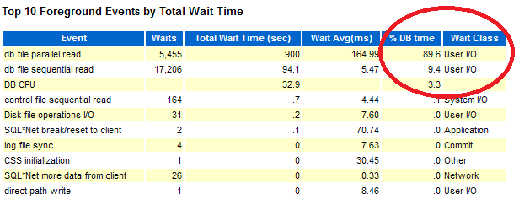
Slow I/O - Little CPU Usage
Slow down the storage on the VM by flushing cache on host
Run SLOB workload again
  storage serves I/O at high latency and delivers only 300 IOPS)
# free && sync && echo 3 > /proc/sys/vm/drop_caches && free

Slide 32
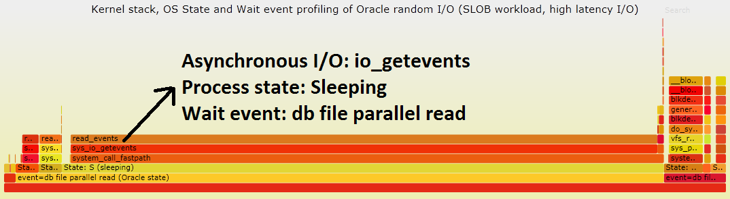
Flame Graph and Analysis
The case of slow I/O
Most of the time spent in sleep mode
  Waiting to reap asynchronous I/O: io_getevents
Compare:
  In the case of low-latency/high IOPS most time was spent on io_submit, as io_getevents was very fast

Slide 33
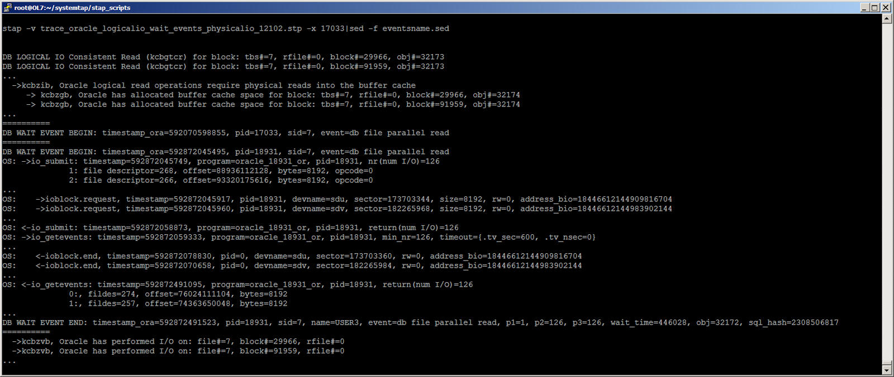
Something about Async I/O
Asynchronous I/O io_submit and io_getevents:
  Flame graphs show where most time is spent
  Tracing shows all actions. Example with SystemTap:

Slide 34

Perf
Perf_events is a Linux profiler tool for
  performance counters (PCL)
  events observer (LPE)
Integrated into the kernel
  Available for kernel versions >= 2.6.31
  E.g. available on RHEL/OL 6 and 7.
Safe to use on production systems
Notes:
Perf is a user tool for performance analyzing and process profiling available in Linux
it is capable of statistical profiling of the entire system
It leverages perf_event interface which is available in all kernel version since

Slide 35
On-CPU Flame Graph and Stack Profiling with Perf
1. Collect on-CPU stack of the Oracle process under investigation
  99 Hz is a starting point for the sampling frequency
  Default event: cpu-cycles on physical machines and cpu-clock on VMs
2. Dump stack traces in a text file
  3. Get scripts: https://github.com/brendangregg/FlameGraph
4. Create a flame graph
  $ perf record -a -g –F 99 -p <pid of process> sleep 10
  $ perf script > myperf_script.txt
cat myperf_script.txt|
../FlameGraph/stackcollapse-perf.pl |
../FlameGraph/flamegraph.pl --title "My Flame Graph"

Slide 36
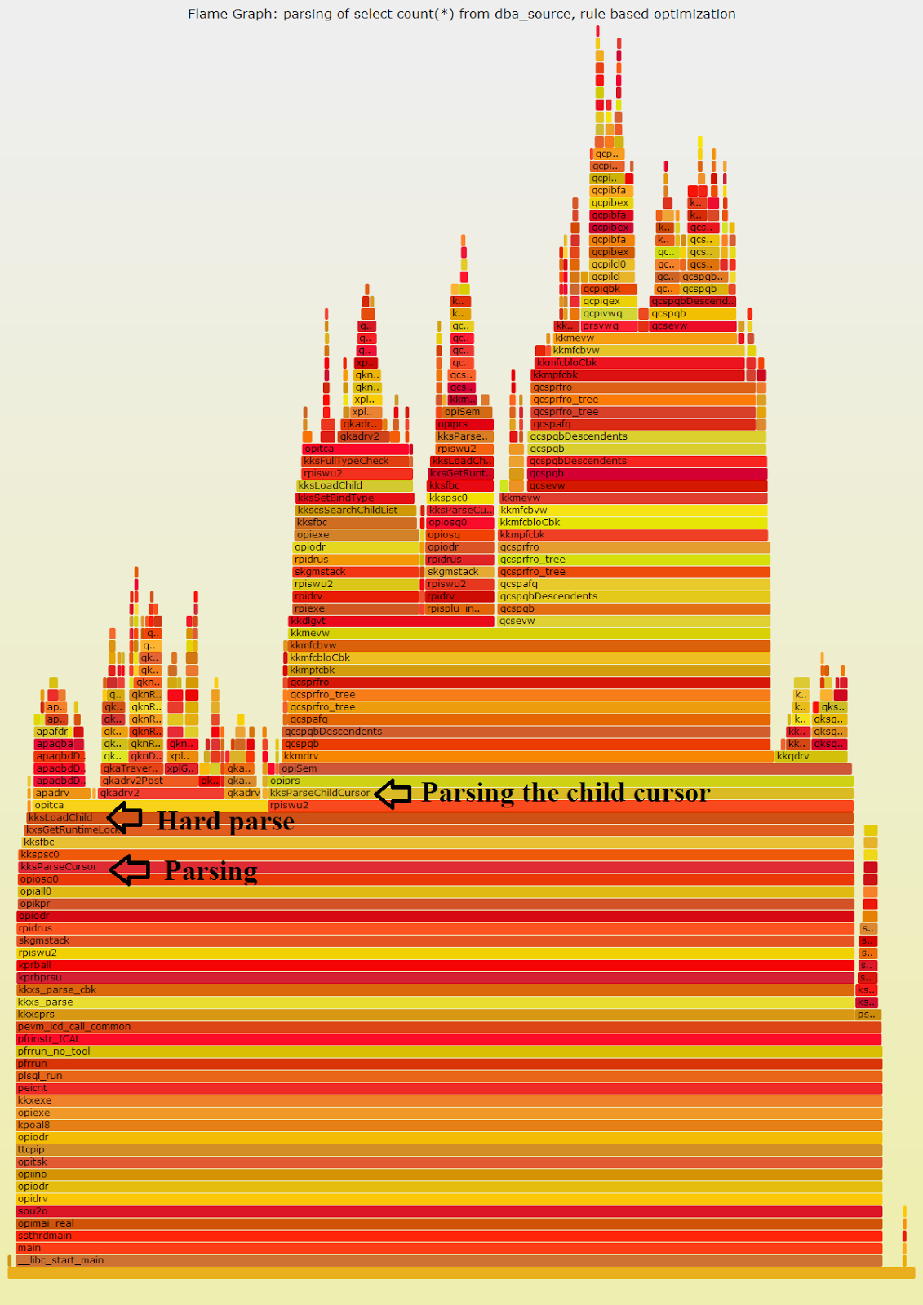
Example 1/3: parsing with rule based optimization
Data collected with perf
Sampling rate
100 KHZ:
option -F 100000
Notes:
For test purposes: alter session set optimizer_mode=RULE;

Slide 37
Navigating Oracle Functions Names
  Not documented, but some hints at:
    “ORA-600 Lookup Error Categories” (formerly 175982.1, now at Doc ID 1321720.1)
Search on MOS or Google for it
Understand from context, educated guess
A few Oracle kernel modules exposed with oradebug
  SQL> oradebug doc COMPONENT
Examples:
  kks prefix -> support for managing shared cursors/ shared sql
  kksLoadChild -> related to hard parse
  kksParseChildCursor -> soft parse
  'apa' (Access Path Analysis?), 'kko' (Kernel Kompile Optimizer?), 'kkq' (Kernel Kompile Query?)

Slide 38
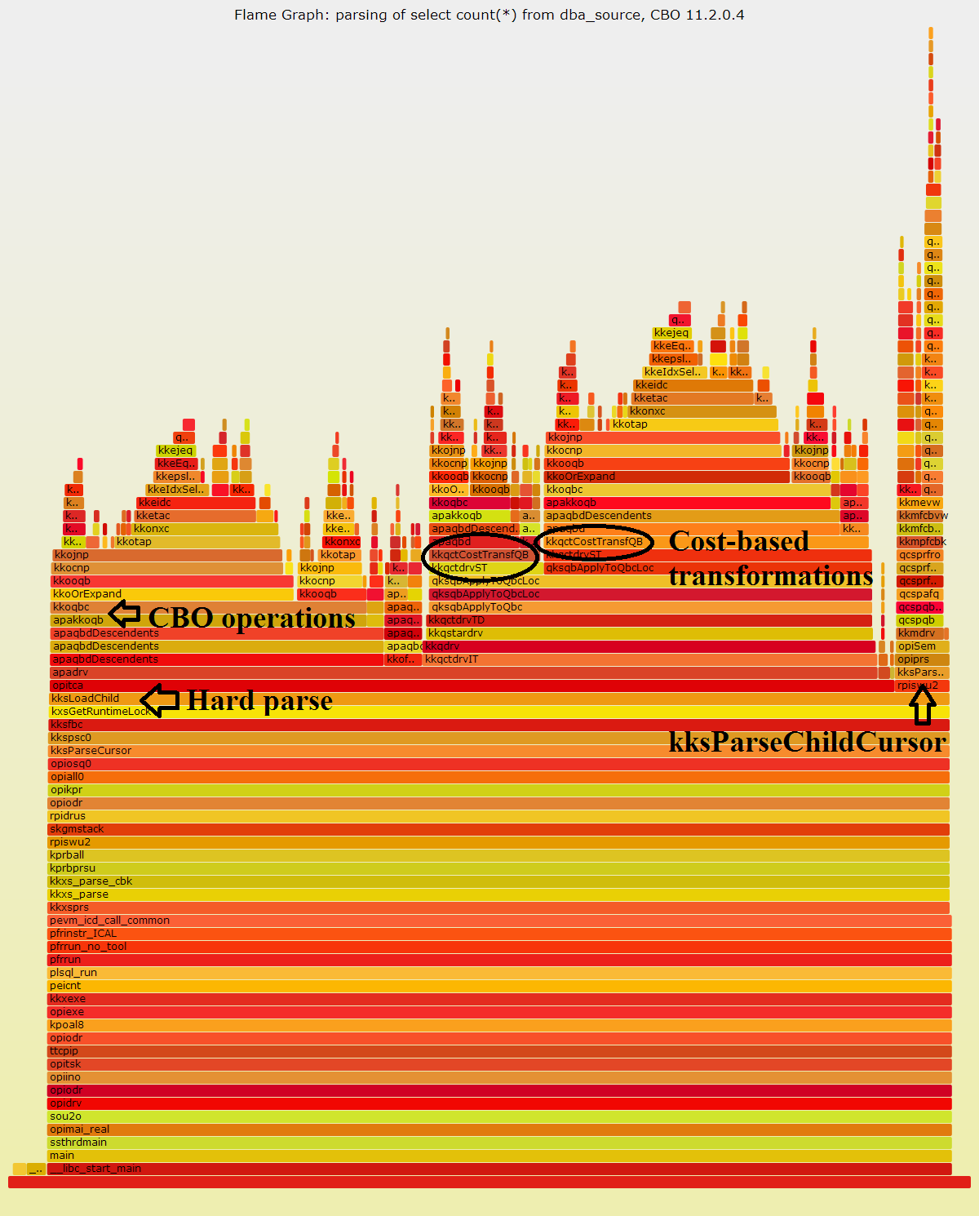
Example 2/3: cost based optimization
Data collected with perf
Samplig rate:
-F 100000

Slide 39
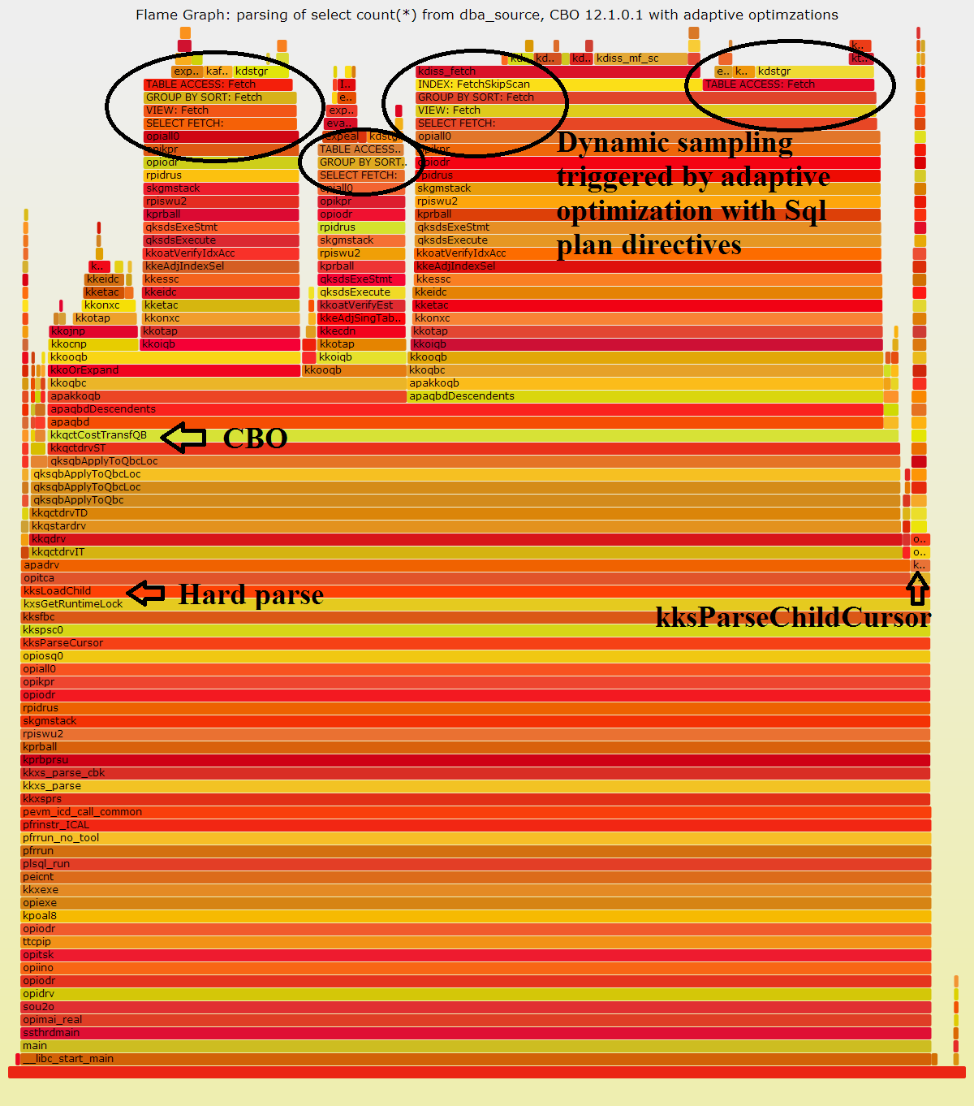
Example 3/3:
12c with adaptive_optimizer_features=TRUE
Data collected with perf
High rate sampling:
-F 100000

Slide 40
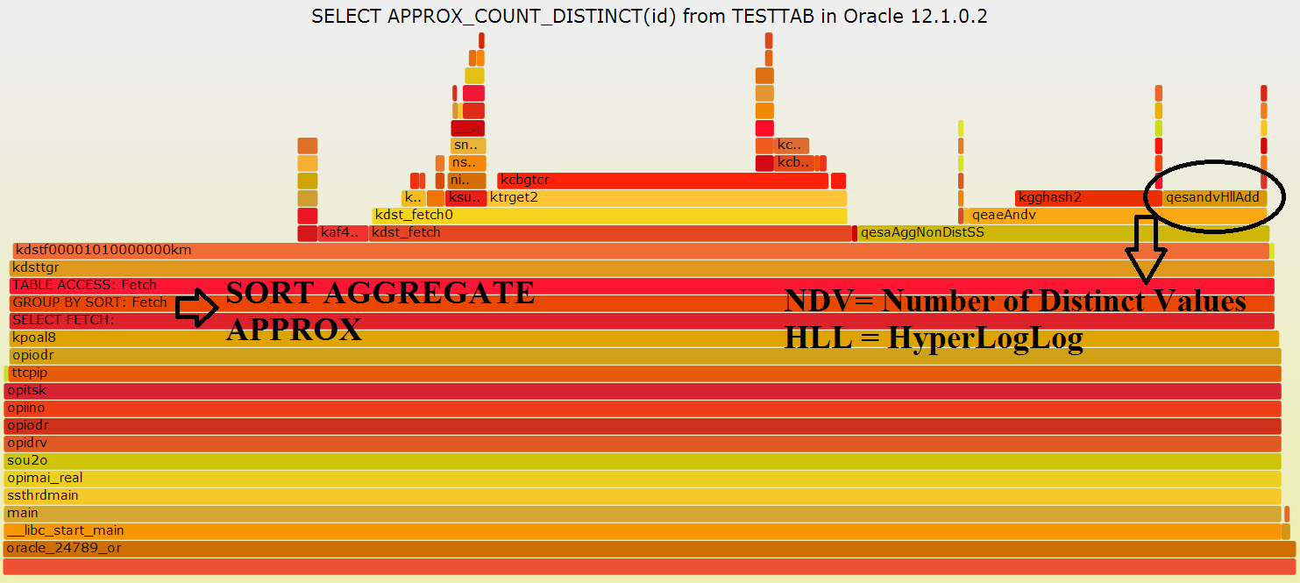
Flame Graph: Internals Investigations
New function in 12.1.0.2: approx_count_distinct
  Scalable (no need for large sort) cardinality estimation
  Implementation of the Hyper Log Log algorithm?
Notes:
Select count(distinct COL) requires sorting data proportional to the cardinality of COL. In some cases this can be very large and need to spill to TEMP, therefore very slow.

Slide 41
Execution Plans and QER Functions
Functions with “qer” prefix
  Query Execution Rowsource
  Expose the execution plan steps
  Example from os_explain by Tanel Poder
  s/qerim/INDEX MAINTENANCE: /g;
  s/qerix/INDEX: /g;
  s/qerjot/NESTED LOOP JOIN: /g;
  s/qerjo/NESTED LOOP OUTER: /g;
  s/qerle/LINEAR EXECUTION IMPLEMENTATION: /g;
  s/qerli/PARALLEL CREATE INDEX: /g;
  s/qerlt/LOAD TABLE: /g;
  s/qerns/GROUP BY NO SORT: /g;
  ...

Slide 42
Additional Steps for Oracle Flame Graphs
4a) Extract sed commands from os_explain script (by Tanel Poder)
4b) Create the flame graph using os_explain mapping for rowsource functions
\
  wget http://blog.tanelpoder.com/files/scripts/tools/unix/os_explain
  grep "s\/q" os_explain > os_explain.sed
cat myperf_script.txt|
sed -f os_explain.sed|
../FlameGraph/stackcollapse-perf.pl |
../FlameGraph/flamegraph.pl --title "My Flame Grapg" >Figure1.svg

Slide 43
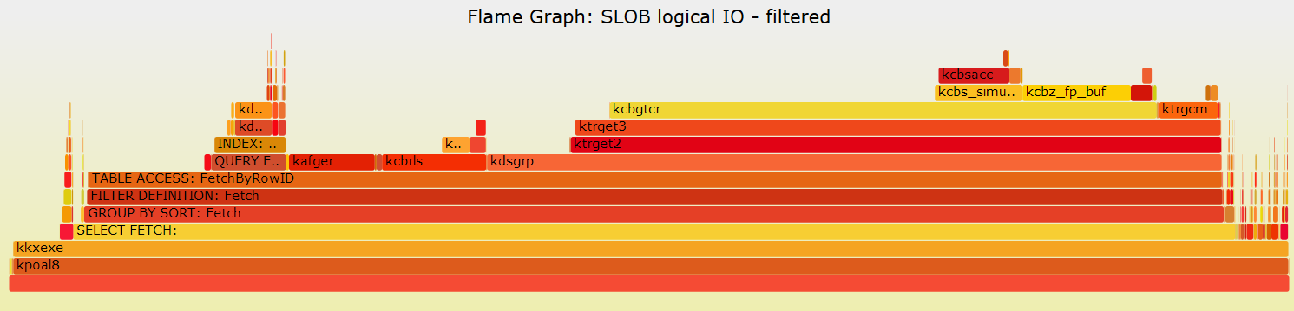
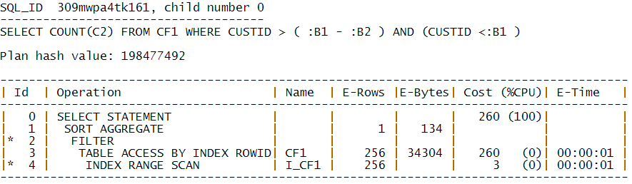
Filtered Flame Graphs
Create flame graph for query execution operations and functions that start with ‘k’:
grep -i -e qer -e opifch -e ' k' -e ^$ myperf_script.txt|
sed -f os_explain.sed|
../FlameGraph/stackcollapse-perf.pl|
../FlameGraph/flamegraph.pl >Figure2.svg
kcbgtcr = Kernel Cache Buffers Get Consistent Read
Notes:
Kernel Cache Buffers Get Consistent Read
Used for consistent reads

Slide 44
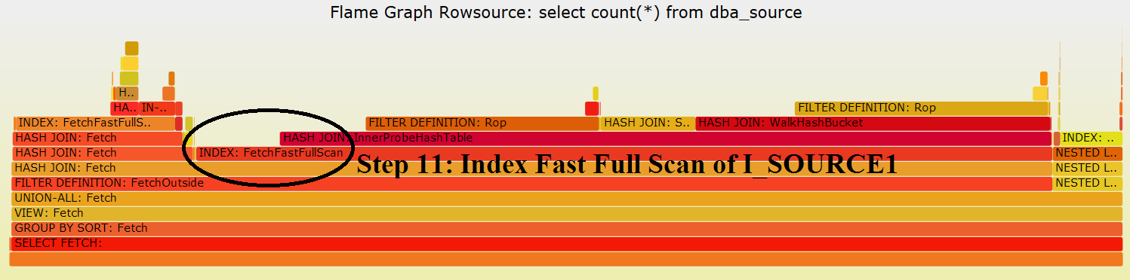
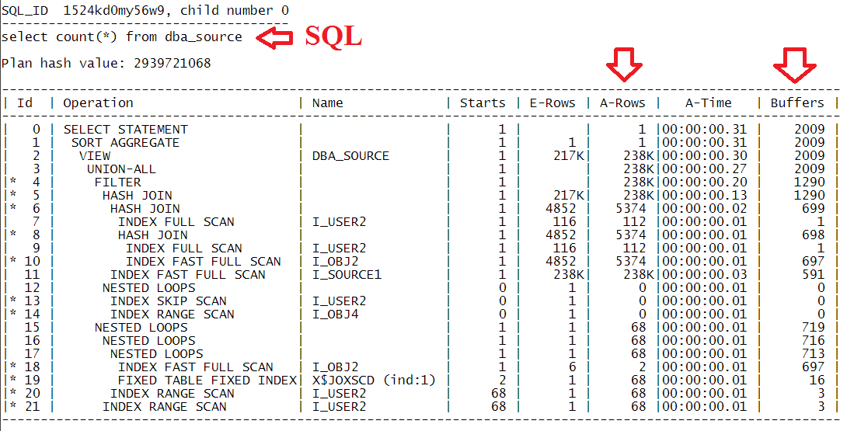
Flame Graphs of Execution Plans
…

Slide 45
Queries on Cached Data
Trend -> servers with large amounts of memory
  Logical I/O becomes critical: “RAM is the new disk”
  .. but without wait events
Example query and data:
  select cust_city, avg(cust_year_of_birth) from Customers group by cust_city;
  Customers table: 911 M rows, 23 columns, 21M 8K blocks, cached in buffer cache

Slide 46
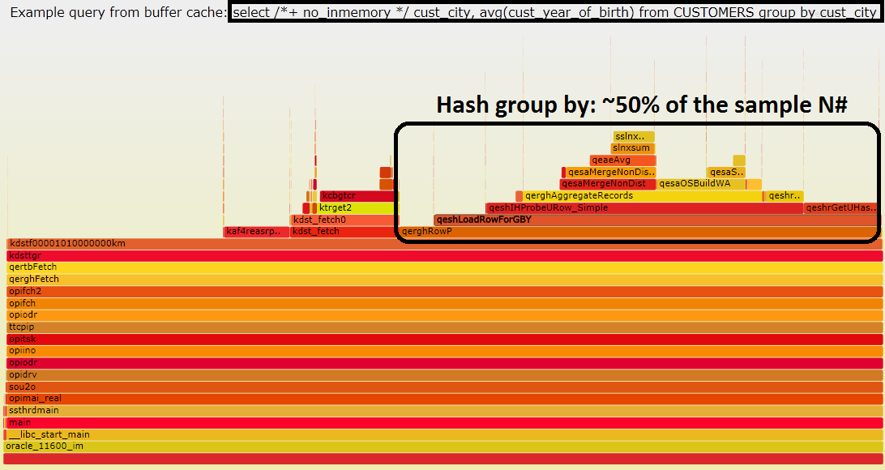
Query From the Buffer Cache
Time: 287 sec, ~50% on “group by”. 21M blocks
  Rows Row Source Operation
  --------- --------------------------------------------------------
  502 HASH GROUP BY (cr=21024838 pr=0 time=287 sec ..
  910595840 TABLE ACCESS FULL CUSTOMERS (cr=21024838 pr=0 time=161 sec

Slide 47
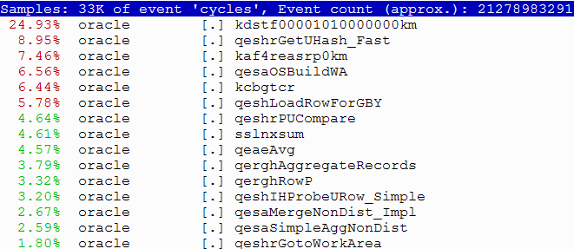
Perf Top vs. Stack Profiling
Perf top – fast and easy
  Explore real-time the surface of the flame graph
  Drill down with stack if needed
  $ perf top [-p <pid of process> ]

Slide 48
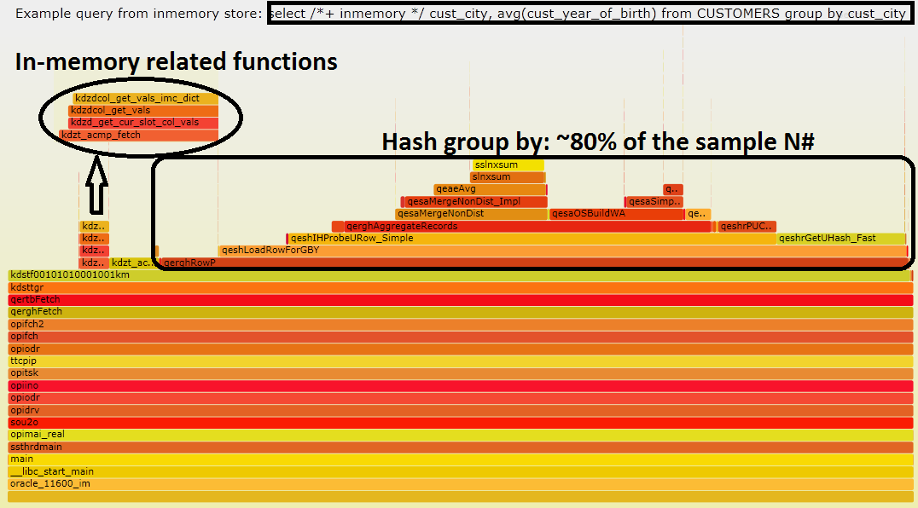
In-Memory Column Store
Query: 193 sec (46 GB). IM more efficient for scan, query time dominated by “hash group by”
  Rows Row Source Operation
  --------- --------------------------------------------------------
  502 HASH GROUP BY (cr=14 pr=0 pw=0 time=193 sec ..
  910595840 TABLE ACCESS FULL CUSTOMERS (cr=14 pr=0 pw=0 time=59 sec ..
Notes:
Compression used: for query high
Compressed size: 46 GB
Number of columns: 23

Slide 49
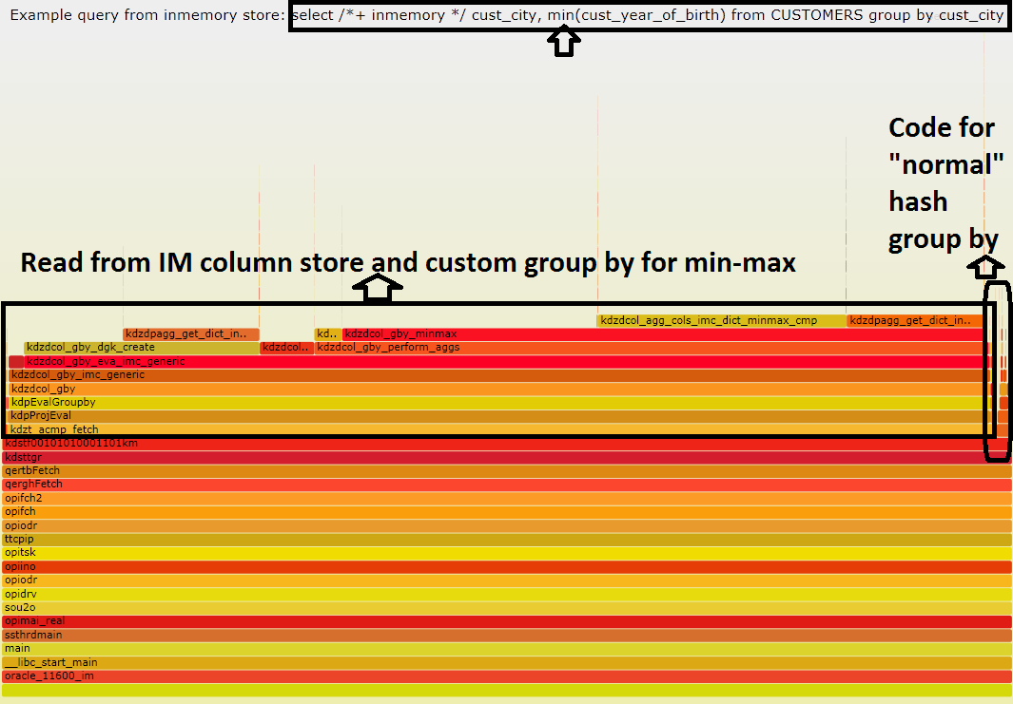
Faster: Min and In-Memory
Query:10 sec, hash group for min is optimized
Notes:
Compression used: for query high
Compressed size: 46 GB
Number of columns: 23

Slide 50
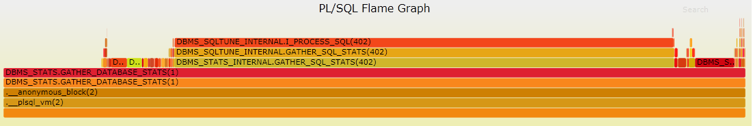
PL/SQL Flame Graphs
Data source: PL/SQL Hierarchical Profiler (DBMS_HPROF, 11g and higher)
  Martin Buechi: OOW 2015, CON2082: Best Practices for Interpreting PL/SQL Hierarchical Profiles for Effective Tuning
  Follow the link to download ora_hprof# package (implemented in Java). Example of the output:

Slide 51
Example: PL/SQL Flame Graph from DBMS_HPROF Profiles
Gather profiler data:
Generate stack collapsed data
  This step can be done on separate (test) machine
  SQL> CREATE OR REPLACE DIRECTORY profiler_dir AS '<path>';
  SQL> exec DBMS_HPROF.start_profiling (location => 'PROFILER_DIR', filename => ‘profiler.txt')
  -- Run here the PL/SQL workload to trace
  SQL> exec DBMS_HPROF.stop_profiling
  SQL> exec ora_hprof#.FLATTEN('PROFILER_DIR', 'profiler.txt', 'plsql_hprofstack.txt')
  $ FlameGraph/flamegraph.pl /<path>/plsql_hprofstack.txt --title 'PL/SQL Flame Graph' > plsql_hprofstack.svg
Notes:
The source code for ora_hprof# is distributed by Martin Buechi
Download Links can be found at: OOW 2015, CON2082: Best Practices for Interpreting PL/SQL Hierarchical Profiles for Effective Tuning

Slide 52
Some Ideas for Improvements of the Techniques and Tools
On-off CPU stack profiler
  Improve on Ptrace_Profile
  more lightweight on userspace stack
Generic PL/SQL stack tracing (beyond hprof)
More extended stack profilers tools
  Generic fields from X$KSUSE?
  More Oracle-related info from SGA
  More OS info from /proc

Slide 53
Acknowledgements and References
Brendan Gregg -> Flame Graphs and more
Tanel Poder -> Oracle internals, including previous original work on stack profiling
Frits Hoogland -> Oracle userspace investigations, perf, gdb
Kevin Closson -> SLOB, Linux perf for Oracle
Stefan Koehler, paper and talk at DOAG 2015
Additional references:
  http://db-blog.web.cern.ch
  http://externaltable.blogspot.com
  https://github.com/LucaCanali

Slide 54
Conclusions
Effective troubleshooting starts with understanding
  What the system is doing, where are the bottlenecks
Oracle instrumentation helps in most cases
  OS tools complement and extend Oracle data
  Notably for CPU-bound workload
Add Stack Profiling and Flame Graph to your toolbox and.. share your findings!
Stack Traces and Flame Graphs for Oracle Troubleshooting
Luca.Canali@cern.ch - @LucaCanaliDB

