Slide 1
From Oracle to Parquet and Spark:
Enabling Scalable Access and Analysis of ATLAS DCS Data
ATLAS Scope meeting
February 12th, 2026
Luca Canali, ADAM and ATLAS-DBA

Slide 2
Luca Canali – A Brief Intro
DBA and Data Engineer
I am part of the ATLAS DBA team
I work on ATLAS Oracle DBs, helping ATLAS developers and database users, under ADAM coordination
I work on helping ATLAS users with using Spark, Hadoop, SWAN

Slide 3


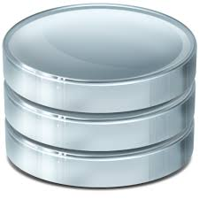

Analysis of DCS Data
DCS data mostly used for online operations
Optimized for writes
We only read small chunks of data, for monitoring, etc
Can we get insights by analyzing large chunks of DCS data?
Working with detector experts for the analyses
Toolset
Let’s not use the DB (Oracle) for this (for stability of online operations, cost, performance)
Solution: import data into a separate and optimized platform for data analysis
DCS data in Oracle

Slide 4






Offloading Data from Oracle for Analytics
Key idea: moving data from databases to platforms for analytics
Export from DBs into files (Parquet format)
Query data with scalable engines (Apache Spark)
Worked with RUCIO, EventIndex, ATLAS DCS and NSW
Python jobs and/or notebooks
Compute and storage on Hadoop and/or Cloud
From Oracle tables to Parquet files
Oracle DB

Slide 5
DCS Schemas Offloaded to Parquet
Data is copied from Oracle to Parquet files
Files hosted in a Hadoop cluster provided by CERN IT (a general-purpose cluster called Analytix)
Whole PVSS schemas exported one-off
In addition, scheduled daily and incremental import for main table (eventhistory table)
Detectors/DB schemas currently exported: PVSSMDT, PVSSMMG, PVSSMUO, PVSSRPC, PVSSSTG, PVSSTGC
Eventhistory table is partitioned by timestamp values (year, month, day)
This provides additional performance boost for selecting data of interest by timestamp range

Slide 6
Technology: why Apache Parquet?
With Apache Spark plus Parquet files we are building a DB for large scale analysis
High adoption in industry and open source for building data lakes and data warehouses
Parquet
Is a columnar data format
Optimized for storing and querying data for large-scale analysis
Uses encoding and compression
Data is stored together with its schema
Works well with Apache Spark, Pandas, and many other tools
Provides a simple way to map DB tables into files

Slide 7
IT Services: SWAN, Spark, and Hadoop
Data analysis platform, interactive and at scale
Running on many CPUs like batch, but interactive (notebooks)
Storage and compute (Hadoop, Spark) from CERN IT
DCS data, used so far (Feb 2026) ~ 4 TB
Fraction of a shared cluster capacity: 1500 cores, 21 PB
SWAN, a CERN service for Python notebooks
https://swan.web.cern.ch/swan/
Integrates LCG releases and Spark
Easy to get started, build from examples

Slide 8
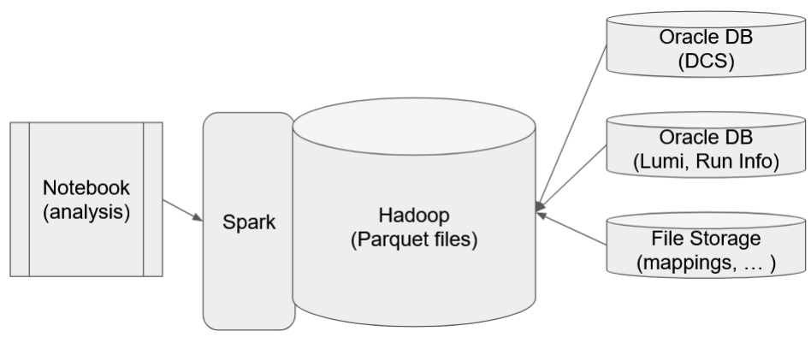
End-to-End Data Analysis Platform
(or S3)
Data is prepared: This system is used as a dynamic database, importing needed information from external data sources into parquet files
Users can code their data analysis in Python using scripts or Jupyter Notebooks (CERN SWAN)
Clusters are available for execution at scale Data APIs that work at scale: Data Frames and SQL

Slide 9




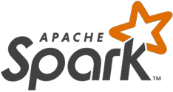



CERN SWAN architecture
https://swan.web.cern.ch/swan/
...
SSO
Web portal
User 1
User 2
...
User n
CERN Resources
CVMFS
(Software)
EOS/CERNBox
(Data/User files)
SWAN as entry point to CERN computing resources

Slide 10
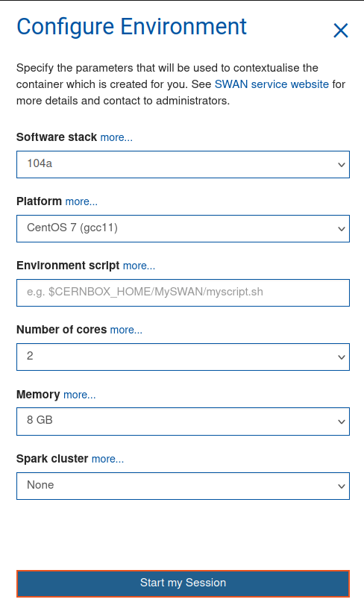
SWAN integration with Hadoop / Spark
SWAN is connected to Hadoop & Spark clusters at CERN
Jupyter extensions available to connect to clusters and spawn Spark executors
Monitor the execution of Spark jobs
Training material on Spark and SWAN: https://sparktraining.web.cern.ch/

Slide 11
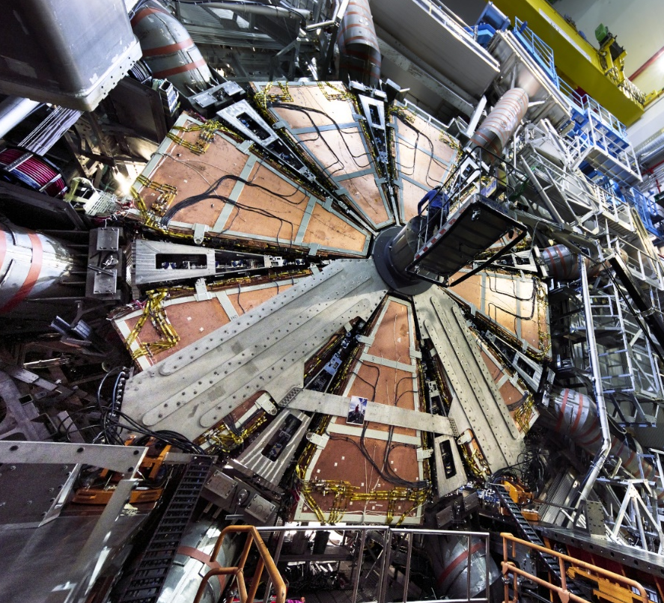
Example of Use by ATLAS Community
New Small Wheel
Interested in analyzing DCS data imported into Parquet and joining it with COOL data among others
A few NSW experts “onboarded” on the use of SWAN and data analytics tools
Work by ATLAS ADAM + Michelle Ann Solis (NSW)
NSW DAQ Link Stability Investigation in 2024
Actions: looking at several parameters monitored in the DCS to help explain instability
Details:
Advancing ATLAS Detector Control System Data Analysis with a Modern Data Platform EPJ Web of Conferences 337, 01110 (2025)

Slide 12
Wrap Up
DCS data from Oracle to a platform for analysis
Pipelines are up and running, maintained by ATLAS DBA team using CERN IT infrastructure
Analysis on SWAN using Python notebooks
Expressive APIs, run at scale on clusters
Example
NSW task force on DAQ link stability investigations
We are happy to help detector experts to start their analysis of DCS data
Contact: atlas-dba@cern.ch

Slide 13
References
Article:
Advancing ATLAS Detector Control System Data Analysis with a Modern Data Platform EPJ Web of Conferences 337, 01110 (2025)
Gitlab project:
https://gitlab.cern.ch/atlas-dba/dcs-offload
SWAN service:
https://swan.web.cern.ch/swan/
Hadoop service:
https://hadoop-user-guide.web.cern.ch/
Training material on Spark and SWAN
https://sparktraining.web.cern.ch/
Acknowledgements:
ATLAS DBA and ADAM, Andrea Formica, Michelle Ann Solis (NSW), IT services for SWAN and Spark/Hadoop

