Slide 1
Basic Physics Analysis Implemented
using Apache Spark
Luca Canali
CERN IT Spark and Analytics Service and ATLAS DBA team
PyHEP, September2022

Slide 2
Motivations and Scope
Context: Spark service at CERN
Recent work on implementing example analyses using PySpark on Jupyter notebooks
  Blog: Can High Energy Physics Analysis Profit from Apache Spark APIs? https://db-blog.web.cern.ch/node/186
I will mix an intro to Spark with notebooks examples
Final thoughts on what I believe works OK with this approach and what needs improvements
Not a goal: compete with state-of-the art software for analysis

Slide 3

Apache Spark Adoption
Who is using Spark, how, and why?
Databricks
  They sell a cloud-based analytics platform, centered around Spark
    Development in the Spark ecosystem (Data Lakehouse, MLFlow)
    They also have custom Spark improvements
  Top contributors and drivers of the open-source development
Cloud vendors
  All offer user-facing “Big Data” platforms, typically including Spark
Many tech giants use it internally
  Facebook, Apple, MS, Baidu, Netflix, etc
  Some contribute back to Spark development (Apache Spark PMCs)

Slide 4
Spark @ CERN
Key component of the Hadoop platforms.
  IT monitoring, IT security
  Experiments computing data (e.g. reports for the Rucio project)
  Physics: RDataFrame, CMS Spark, CMS Muon POG
We also provide Spark on Kubernetes clusters
User-access
  Notebooks, often via SWAN. Some use of Spark on R
  Batch jobs: Python, Scala, Java
NXCals platform
  Critical and large (~PBs) logging system for the accelerator complex
  Platform based on Hadoop, API based on Spark

Slide 5
Demo 1
Can Apache Spark run basic physics analysis?
Let’s start with a “Hello World!” example
Dimuon mass spectrum analysis at
https://github.com/LucaCanali/Miscellaneous/tree/master/Spark_Physics

Slide 6
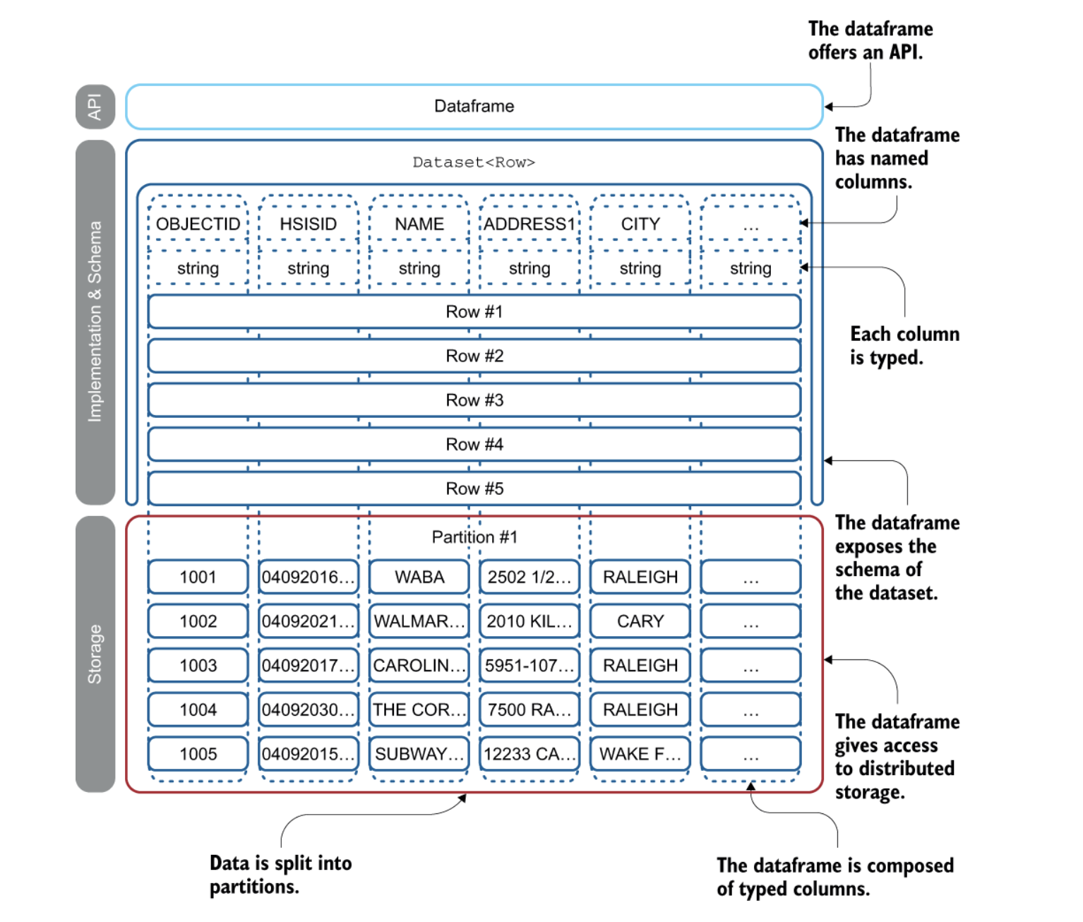
Main Data Abstraction: Spark DataFrames
DataFrame is a table-like abstraction
  similar to Pandas DF
Handles data with a schema
DFs are partitioned and immutable
  enables parallel execution
  and fault tolerance at scale
Figure from “Spark in action”, Jean-Georges Perrin, Manning, 2020
Notes:
Qua o come prima slide della dataframe API?

Slide 7
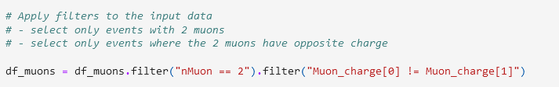

DataFrame API Basics
Selections and projection are easily scalable
Filter operations naturally fit with the DataFrame API
Expressions and formulas

Slide 8
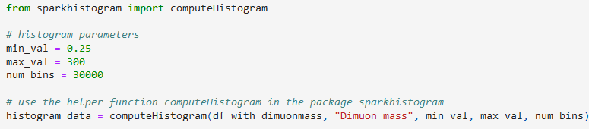
Histograms with the DataFrame API
Histograms are generated using Spark DataFrame API
  Data aggregation/shuffle with Spark, can run at scale
  Details hidden in a small custom package: sparkhistogram

Slide 9
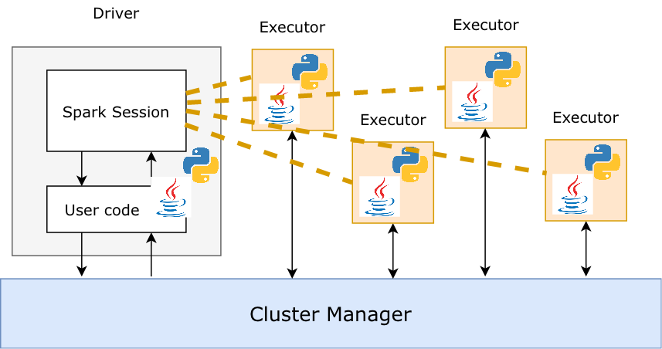
How Spark Runs Jobs at Scale

Slide 10


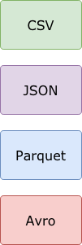
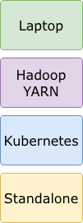
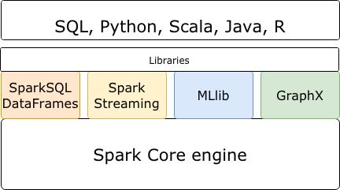
Apache Spark Ecosystem
Use cases
Data
formats
Clusters
ROOT
Storage

Slide 11


Apache Spark Clusters at CERN
Spark running on clusters:
  YARN/Hadoop -> established, use with HDFS storage
  Spark on Kubernetes -> recommended when using EOS or S3 (cloud model)
Accelerator logging (part of LHC infrastructure) | Hadoop - YARN - 41 nodes (Cores - 1800, Mem - 18 TB, Storage – 13 PB)
General Purpose | Hadoop - YARN, 58 nodes (Cores – 2.6k, Mem – 30 TB, Storage – 21 PB)
Cloud containers | Kubernetes on Openstack VMs, Cores - 270, Mem – 2 TB Storage: remote HDFS or custom storage (CERN EOS, for physics data, S3 on Ceph also available). Note: GPU resources available.

Slide 12





SWAN Integration with Apache Spark
SWAN service: https://swan.web.cern.ch/swan/
  Notebooks for web-based analysis
Integrated with CERN Spark Clusters
  Reduces configuration complexity for users
CERN software environment
  Software from CVMFS
Graphical Jupyter extensions developed
  Spark Connector
  Spark Monitor
Access to Spark Clusters
  NXCals: – Dedicated cluster for accelerator logging
  Analytix: – General purpose YARN cluster
  Cloud Containers: – General purpose Kubernetes cluster
  Storage access: HDFS, EOS, S3
User Notebook
Spark Cluster
Spark Driver
Spark Executors
Python task
Python task
Python task
Notes:
One liner to explain spark-> distributed framework for big data analysis
big point -> local - remote

Slide 13
Example 2
Dimuon mass spectrum analysis on a cluster:
https://github.com/LucaCanali/Miscellaneous/tree/master/Spark_Physics

Slide 14
Spark can Handle Complex Schemas
Example of complex schema for HEP
schema = "event LONG, HLT struct<flag1:boolean, flag2:boolean>, muons ARRAY<STRUCT<pt:FLOAT, eta:FLOAT, phi:FLOAT, mass:FLOAT>>"
df.printSchema()
|-- event: long (nullable = true)
|-- HLT: struct (nullable = true)
| |-- flag1: boolean (nullable = true)
| |-- flag2: boolean (nullable = true)
|-- muons: array (nullable = true)
| |-- element: struct (containsNull = true)
| | |-- pt: float (nullable = true)
| | |-- eta: float (nullable = true)
| | |-- phi: float (nullable = true)
| | |-- mass: float (nullable = true)

Slide 15
Handling Arrays
Nested data is hard to handle
  Does not fit naturally to DataFrame and SQL operations
Available solutions in Spark
  Array functions
    Several available, example: array_min, array_sort, array_zip, …
  “Explode” function
    Transforms array values into DataFrame rows
  Higher order functions
    Process map/filter/aggregate on arrays elements
  UDF: User-defined functions
    General solution.
    Spark UDF can be in Python or Scala

Slide 16
Demo 3
HEP analysis benchmark notebooks
https://github.com/LucaCanali/Miscellaneous/tree/master/Spark_Physics
Thanks to: https://iris-hep.org/projects/adl-benchmarks-index.html

Slide 17
Demo 4
Outreach-style analysis
Using Spark and Parquet: more familiar tools to data scientists outside HEP
See example Higgs boson analysis at:
https://github.com/LucaCanali/Miscellaneous/tree/master/Spark_Physics

Slide 18
Lessons Learned and Wrap-up

Slide 19
What Spark Can Offer To HEP
Spark DataFrame API:
  Provide powerful abstractions and rich language(s)
    Both for data preparation and analysis
  Mature and an industry reference
  Can handle complex schemas
Run DataFrame locally and at scale using distributed computing
    Runs on clusters and cloud (YARN/Hadoop, Kubernetes)
    HPC and batch: can run Spark stand-alone (requires extra integration work)
Integration with a large ecosystem
    File formats: Parquet, csv, ROOT, …
    Storage systems: HDFS, S3, EOS, ...
    External systems: databases, elastic search, streaming, etc

Slide 20
Performance Gap
Apache Spark Performance
  Identified several areas of improvement for Apache Spark (3.3)
Python UDF performance
  Sending data to Python workers has been improved but still slow
Spark functions
  Higher order functions performance for array processing need improvements
  More array functions and functions for Lorentz vector processing?
Spark engine
  Apache Spark does not (yet) have vectorized execution
  State-of-the-art HEP tools have large parts running native code vs. Spark is currently mostly Scala and Java code running on the JVM (JIT compiled).

Slide 21
Open Questions: Data Formats
ROOT data format ingestion is not optimized for Spark
  It’s a hard job with limited resources
  Kudos to Andrew for Laurelin library + uproot team
Apache Parquet and ORC
  Optimized reader for Spark, supported by a large community
The flatter the data the better
  Data in nanoAOD format already much easier to process with Spark than deeply nested AOD

Slide 22
Plans and Future Work
Gather feedback
Develop further examples and benchmarks
  Trailing on work done with Coffea/Awkward array and with ROOT/RDataFrame
Piggyback on Apache Spark improvements
  Spark is still improving quite fast
Work with community (HEP and Spark)
  We noticed some interest by Apache Spark committers on understanding HEP use cases
  Occasionally work together, as in the case of arrow UDF, also currently open SPARK-34265 and SPARK-38098
  Some physicists also interested in trying out Spark ?

Slide 23
References + Acknowledgments
Machine Learning Pipelines with Modern Big Data Tools for High Energy Physics, Matteo Migliorini, Riccardo Castellotti, Luca Canali, Marco Zanetti, Comput Softw Big Sci 4, 8 (2020).
Using Big Data Technologies for HEP Analysis, M. Cremonesi et al., EPJ Web of Conferences 214, 06030 (2019)
Evolution of the Hadoop Platform and Ecosystem for High Energy Physics, Z. Baranowski et al., EPJ Web of Conferences 214, 04058 (2019)
Big Data Tools and Cloud Services for High Energy Physics Analysis in TOTEM Experiment, V. Avati et al., 2018, Proceeding of: 2018 IEEE/ACM International Conference on Utility and Cloud Computing Companion (UCC Companion)
CMS Analysis and Data Reduction with Apache Spark, O. Gutsche et al. 2018 J. Phys.: Conf. Ser.1085 042030
Evaluating Query Languages and Systems for High-Energy Physics Data, Dan Graur, Ingo Müller, Mason Proffitt, Ghislain Fourny, Gordon T. Watts, Gustavo Alonso, Proc. VLDB Endow., Vol 15, Issue 2 (2021).
Get started with Spark at CERN: https://hadoop-user-guide.web.cern.ch/
Thanks:
  to the teams in the IT Hadoop, Spark and streaming service, and in the SWAN service, in particular to Riccardo Castellotti.
  to the members and contributors to the (now finished) openlab project on data analysis with CMS
  to Jim Pivarski, Andrew Melo, Lindsey Grey for discussion and their work on Spark arrow integration improvements and Spark-ROOT format integration
  Lukas Heinrich, Gordon Watts, Ghislain Fourny, Ingo Müller, for discussions.
  Ruslan Dautkhanov and Hyukjin Kwon from Databricks for their work and support on adding mapInArrow
  Matteo Migliorini and Marco Zanetti for the work on ML pipelines.

